Slide 1


Integración de sistemas CMOS
Martín Carrá / Hernán Romero / Mariano García Inza / Benjamín Reyes / Patricio Pérez Preiti / Pablo Gardella

Slide 2
Presentación de la materia

Slide 3
Objetivo de la materia
Comprender cómo, a partir de una serie de necesidades, se generan requisitos ('requirements') y restricciones ('constraints'), y cómo estos sirven como base para conceptualizar y desarrollar un circuito de señal mixta en su nivel superior ('top level'). Este proceso debe considerar las interacciones del circuito con el entorno externo, asegurando que cumpla con los requisitos funcionales y de compatibilidad definidos.

Slide 4
Programa sintético
Introducción a la ingeniería en sistemas
Sensores CMOS
Circuitos de Interfaz
Conversores ADC / DAC
Arquitectura de IC de señal Mixta
Requerimientos y protecciones ESD
Introducción a EMC
Martín Carrá
Hernán Romero / Mariano García Inza
Hernán Romero / Mariano García Inza
Benjamín Reyes
Martín Carrá / Hernán Romero
Patricio Pérez Preiti
Pablo Gardella

Slide 5
Staff Docente
Ing. Martín Carrá.
Ing. Hernán Romero.
Dr. Ing. Mariano García Inza.
Dr. Ing. Benjamín Reyes
Ing. Patricio Pérez Preiti.
Ing. Pablo Gardella.

Slide 6
Staff Docente
Ing. Hernán Romero
Academic Milestones
Engineering Degree (1992– 1999):
Graduated as an Electronic Engineer from the University of Buenos Aires, Faculty of Engineering.
Specialized Training in CMOS Technology:
Advanced Analog Design Technique MEAD course, including ultra-low voltage design.
Specialized Training in Delta-Sigma Design:
Practical approaches to Delta-Sigma design MEAD course
Continuous Time Delta Sigma design MEAD course.
Professional Milestones
Analog Design Engineer at Allegro Microsystems (2001 –2004)
Design of Analog and Mixed-signal Hall effect IC sensors for linears, digital position and GTS apps.
Principal IC Design EngineerPrincipal IC Design Engineer (2004-2010)
Lead Designer of Analog & Mixed Signal Hall effect IC sensors, focused on linear sensors for automotive and current sensor apps, in CMOS and BICMOS processes.
Advanced Sensors Technologies Design Manager - Sr IC Design Engineer (2010-2020)
Product development group manager / IC design engineer of Analog & Mixed Signal Hall effect Linear sensors, from architecture development to circuit design.
Innovation Product Acceleration Design Manager (2020-2022)
Prototype development for new Technologies.
Senior Member of Technical Staff, Design – Innovation (2022-2023)
Prototype development and feasibility for new Technologies.
Distinguished Member of Technical Staff, Analog Design (present)
Prototype development and feasibility for new Technologies.
Autor of 52 published patents in the US
Two Allegro Innovation Awards (2017: US 9389060 & 2022: US11047933):

Slide 7
Programa sintético
Introducción a la ingeniería en sistemas
Sensores CMOS
Circuitos de Interfaz
Conversores ADC / DAC
Arquitectura de IC de señal Mixta
Requerimientos y protecciones ESD
Introducción a EMC
Martín Carrá
Hernán Romero / Mariano García Inza
Hernán Romero / Mariano García Inza
Benjamín Reyes
Martín Carrá / Hernán Romero
Patricio Pérez Preiti
Pablo Gardella

Slide 8
Agenda Sensores CMOS
Dyanmic Cancellation Techniques
Autozero vs Chopping
High Level Comparison
Auto-zero Amplifiers
Chopping Stabilization
Chopper-Stabilized Amplifier

Slide 9
Interface Circuits

Slide 10
Dynamic offset Cancellation

Slide 11
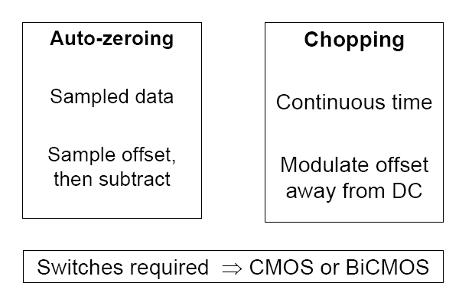
Autozero vs Chopping

Slide 12
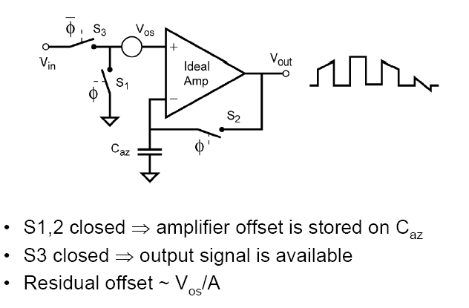
Autozero Amplifiers
_Φ
Φ
Vin*A
Vos’
(V_{ores} = V_{os}’-V_{os})

Slide 13


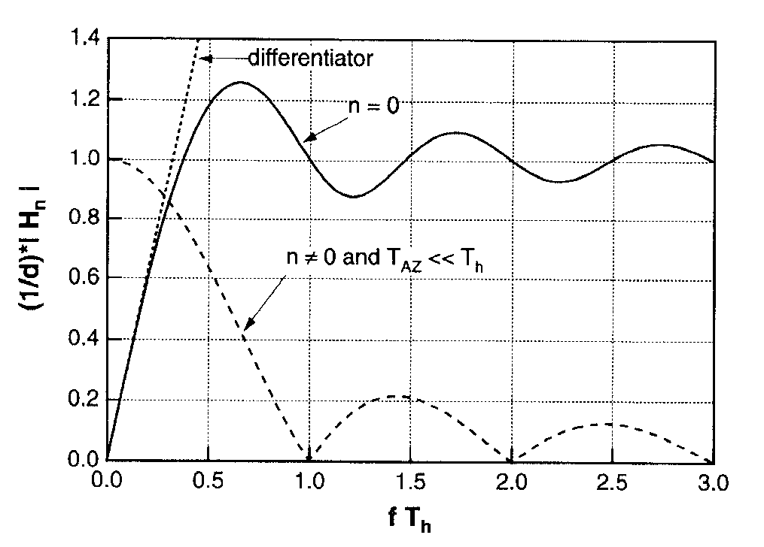
Autozero Limitations : Noise Aliasing
Vn+
Noise model
If vn assumed stationary
¹

Slide 14
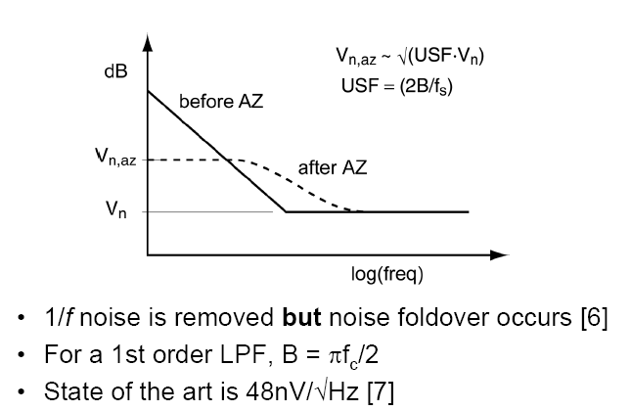
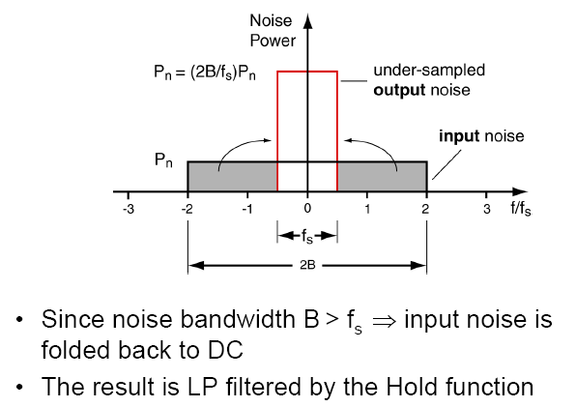
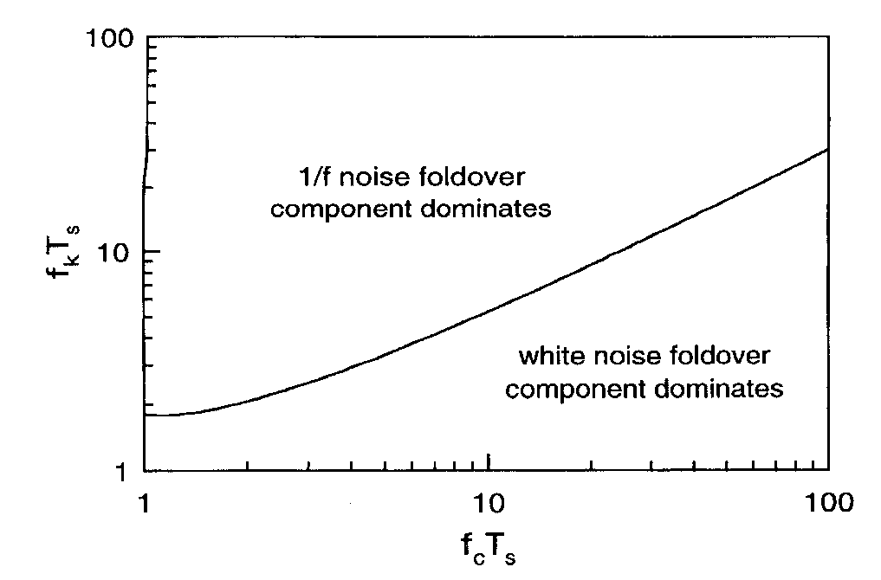
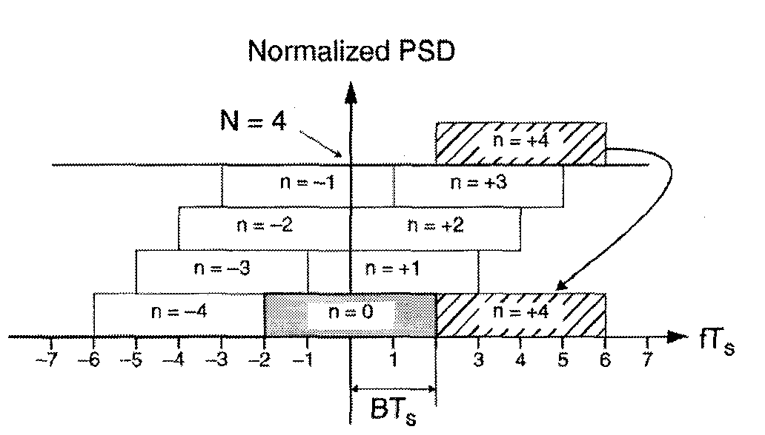
Autozero Limitations : Noise Aliasing
1/f noise is removed though
1/f replicas lie out of band
(Noise BW)
Flicker noise USF
White noise USF

Slide 15
Autozero Limitations : Summary
OFFSET & 1/f noise are completely removed (f_{ch} > f_{K}=1/f)
Effective gain is higher than conventional amplifier
Vn+
In Band WN power is Increased (aliasing)
Residual offset is high for low A
Output is not valid all the time (no continuous-time output)

Slide 16
Chopper-Stabilization

Slide 17

Chopper Stabilization Concept
Modulation process
VOFF + VN
smoothing filter
SF
VSIG
A(f)
VSIG
f_{A}>> fch
VOFF
(1)
(2)
(4)
(3)
Modulated offset & 1/f
VSIG
VSIG
f / fch
f / fch
1
3
5
1
3
5
B_{A}
Modulated signal
Modulated offset & 1/f
VSIG
VOFF + VN
1/f
f / fch
f / fch
1
3
5
1
3
5

Slide 18
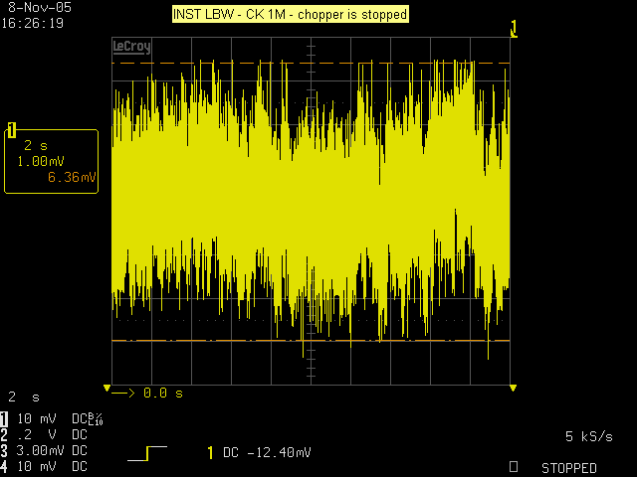
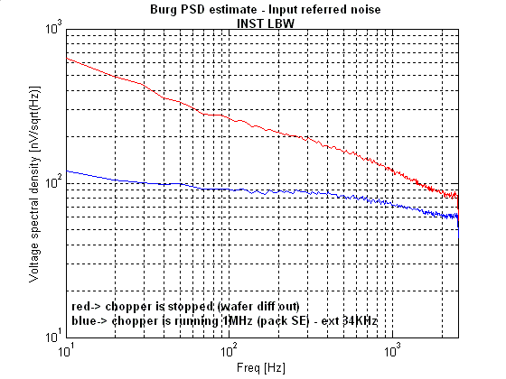
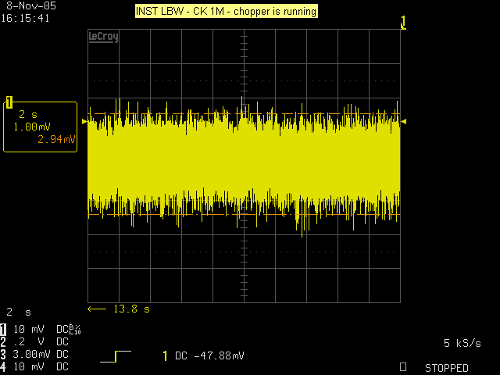
Chopper Stabilized Amplifiers – Concept II
Not only offset is removed !
f_{k} ~ 2KHz
Note: scope plots scale: 2sec/div

Slide 19
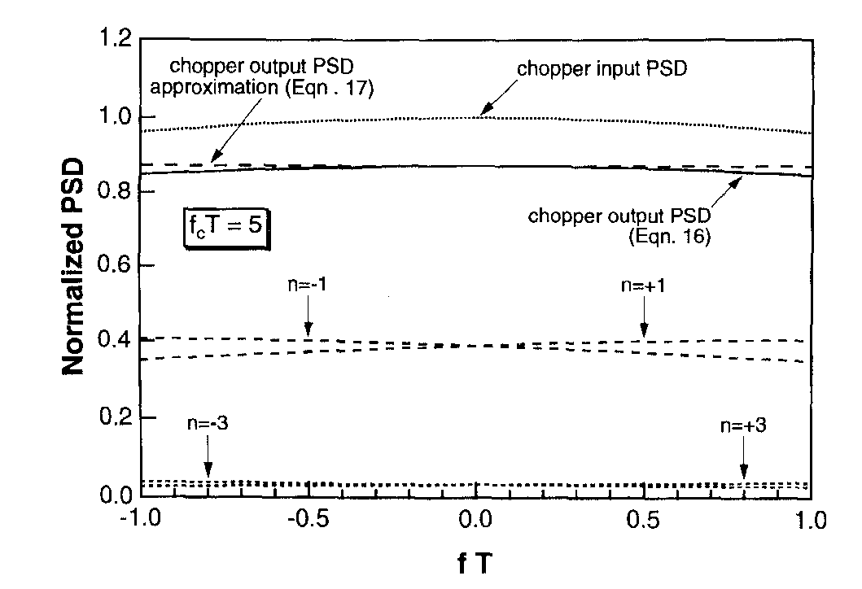
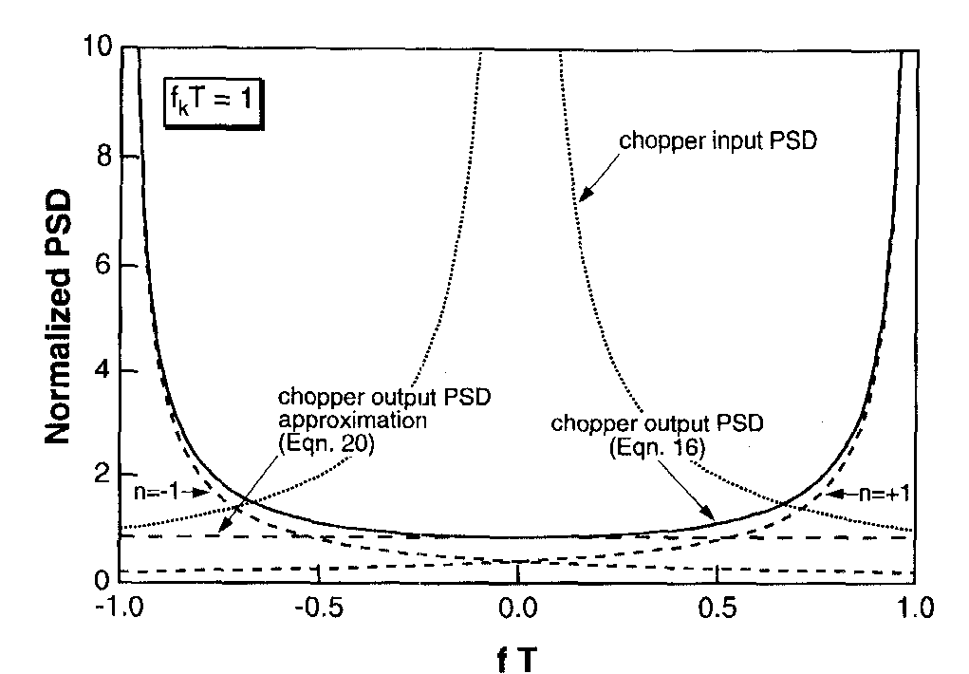
Chopper Stabilization Concept III
This is a modulation process…
WN is then modulated too…
So baseband noise is again aliased!, but (as opposed to AZ) …
all input signal spectra replicas are weighted such that the sum of all coefficients equals 1
If vn assumed stationary
Chopper’s output PSD

Slide 20
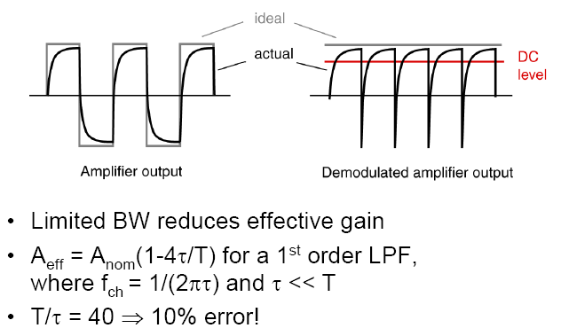
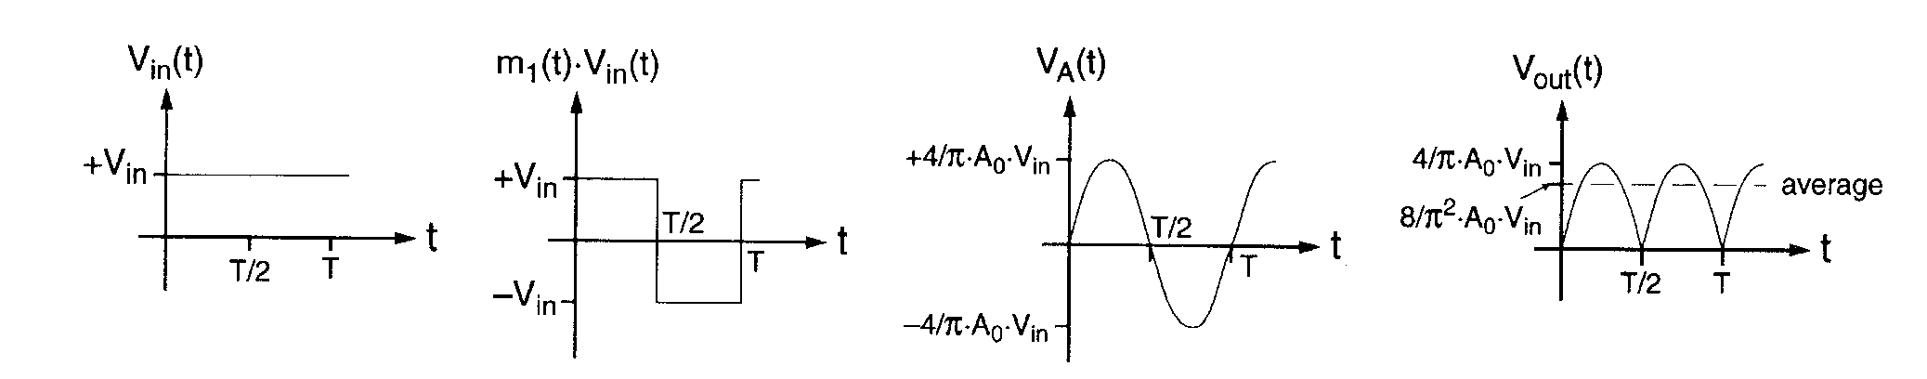
Chopper Stabilization Limitations
Rule of thumb → f_{A} > 5 fch
or
CLOSED LOOP AMPLIFIER (High loop gain can tolerate LF gain loses)
Another example…

Slide 21
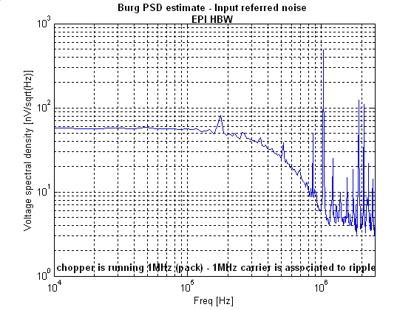
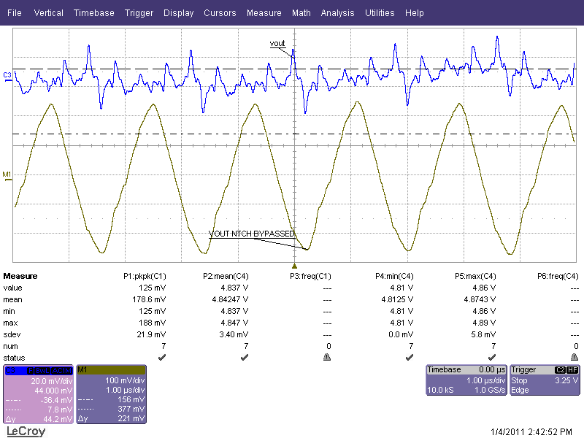
Chopper Stabilization Limitations
1-pole LPF
For a 2-stage chopped amp
Proportional to
offset & f_{LPF}/f_{CH} ratio

Slide 22
Chopper Stabilization Limitations
What causes residual offset?
Modulated RESOFF & CM errors
1
2
3
4
5
f / fch
RESOFF & CM errors
f / fch
1
2
3
4
5
Charge injection at the input chopper switches = f(f_{ch}) !!

Slide 23
Chopper Stabilization Limitations
Input-referred Amplifier’s Residual offset
IMPORTANT
The residual offset is proportional to the chopping frequency!

Slide 24
Chopper Stabilization Summary
OFFSET & 1/f noise are completely removed (f_{ch} > f_{K}=1/f)
In Band WN power is NOT Increased
Noise before chopping
Noise after chopping
f_{K}: 1/f corner frequency
ripple
Delay Increases with f_{CH}/f_{LPF} (OSR)
Residual offset α f_{ch}
HF Ripple proportional to (lower effective gain):
offset voltage
1/OSR
White noise
1
f/fch
f-3dB= 1/OSR
CT LPF
(N x 20dB/dec roll off)
Modulated 1/f noise

Slide 25
Chopper Stabilization Summary
TRADE OFFS
(1) | Residual noise (band-limited White noise + Ripple (harmonic noise)) vs. SNR / Dynamic range / Delay
(2) | Residual Offset vs. Efficiency
(3) | BW limitation (speed) vs. Gain accuracy (Temp-co, linearity …)

Slide 26
Dynamic offset compensation comparison

Slide 27
DOC High Level Comparison
Summarized performance of different offset cancellation techniques
 | Bandwidth (delay) | Offset drift | 1/f noise | White noise | Continuous time | Effective gain
Trimming | N | - | - | N | + | +
Auto-zeroing | N | + | + | - | - | +
Chopping | -¹ or N² | + | + | N | +¹ or N² | N / +³
N = Neutral
¹CT filtering or feedback ripple reduction techniques
²Tuned filtering techniques
³ Offset compensation / stabilization techniques – Closed loop chopped amplifiers

Slide 28
Chopper-stabilized Amplifiers

Slide 29
Chopper-Stabilized Amplifiers Fighting Limitations
Fighting Bandwidth
Usual approach
Currents are faster than voltages
Fighting ripple
CT filtering
(DT) Tuned filtering: Track and hold demodulation
(DT) Tuned filtering – revisited: low noise approach
Offset compensation (feedback)
Offset stabilization
Chopped auto-zero
Fighting residual offset
Nested chopping
Guard-banding
Bandpass filtering

Slide 30
Chopper-Stabilized Amplifiers Fighting Bandwidth
How can we alleviate DC gain reduction due to limited BW?
Closed loop amps
DC gain loses are not noticed
High speed chopping
Is it required to chop all gain stages ?
Slew rate requirement highly reduced
Slew rate might be compromised
Currents are “faster than voltages”
Chopped cascodes

Slide 31
Chopper-Stabilized Amplifiers Closed Loop Amplifiers
NEGATIVE FEEDBACK: high loop gain can tolerate LF gain loses without significantly affecting closed loop gain.
Aol
Aol_{eff1}
Aol_{eff2}
Acl
fchop
fchop
fchop
f
dV/dT α VSIG & fchop
VOFF + VN
SF
VSIG
Design Problem !: Very high slew rate requirements
f

Slide 32
Chopper-Stabilized Amplifiers High Speed Chopping
? Gm₂ is left outside chopper: Its offset contribution is negligible if Gm₁*(R_{o1}//R_{i2}) = A1 is large (usually the case) since
So….
↑ Slew rate requirements are reduced Gm₂*R_{L} = A₂ times !!
↑ Stabilization stage provides a first LPF means ! → SF is relaxed
f
VOFF + VN
gm1
gm2
SF
VSIG
f

Slide 33
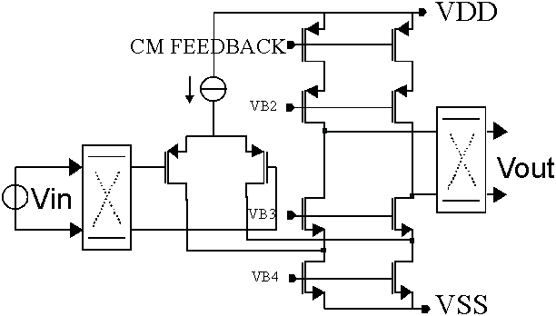
Chopper-Stabilized Amplifiers High Speed Chopping II
f
VOFF + VN
SF
Example of Gm₁
VSIG
gm1
gm2
f

Slide 34
Chopper-Stabilized Amplifiers High Speed Chopping II
f
VOFF + VN
SF
Example of Gm₁
VSIG
gm1
gm2
f

Slide 35
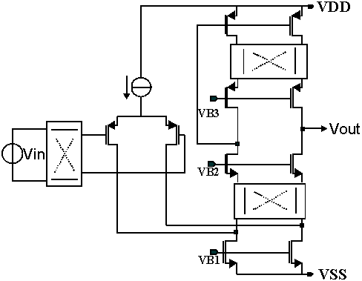
Chopper-Stabilized Amplifiers High Speed Chopping III
What happens if demodulation switches are moved to LOW IMPEDANCE nodes?
↑ Gm₁ becomes a wide-band stage (not limited by following stabilization stage bandwidth)
→ f_{ch} can be increased !
(until V_{resoff} hurts)
↑ Cascode devices provides a first filtering means.

Slide 36
Chopper-Stabilized Amplifiers Fighting Limitations - Overview
Fighting Bandwidth
Usual approach
Currents are faster than voltages
Fighting ripple
CT filtering
(DT) Tuned filtering: Track and hold demodulation
(DT) Tuned filtering – revisited: low noise approach
Offset compensation (feedback)
Offset stabilization
Chopped auto-zero
Fighting residual offset
Nested chopping
Guard-banding
Bandpass filtering

Slide 37
Chopper-Stabilized Amplifiers Fighting Ripple - Overview
Why do we want to further reduce ripple?
Relaxes post-chopper LPF (can be integrated) → allows for lower OSR → Signal delay can be reduced
Improves dynamic range
How can we further reduce ripple ?
CT filtering
Low pass (Conventional chopping)
High pass
Tuned Filtering
T&H demodulation
Offset compensation
Baseband offset
Low noise
Offset stabilization
Modulated offset
Auto-zero
Chopper
Chopped Auto-zero
Discrete or Continuous time output

Slide 38
Chopper-Stabilized Amplifiers Fighting Ripple – HPF topology
VOFF + VN
HPF
SF
VSIG
fo << fch
VSIG
VOFF
(1)
(2)
(3)
(4)
(5)
VOFF + VN
Modulated offset & 1/f
Modulated signal
VSIG
1/f
1
3
5
f / fch
In band
WN PSD is NOT increased ↑
Out of band
Ripple: only proportional to f_{HPF}, not to offset anymore
Delay: proportional to 1/f_{HPF}
VOFF + VN
Modulated signal
VOFF + VN
1/f
Modulated signal

Slide 39
Chopper-Stabilized Amplifiers Fighting Ripple – Tune filtering – T&H demodulation
VOFF + VN
(smoothening)
SF
VSIG
Track & hold demodulation
VSIG
Assuming f_{A}>>f_{ch} →
VOFF
(1)
(2)
(3)
(5)
Sampling is done here…
…and then demodulated…
… and finally averaged
VSIG
(This is the ripple we want to kill!)
(Aliasing takes place!)
(Inverting phase)
VOFF + VN
Modulated signal
Modulated offset & 1/f
1/f
f / fch
1
2
3
4
5
f / fch
1
2
3
4
5
f / fch
1
3
5

Slide 40
Chopper-Stabilized Amplifiers Fighting Ripple – Tune filtering – T&H demodulation (cont)
VOFF + VN
(smoothening)
SF
VSIG
Track & hold demodulation
In band
WN aliasing ! ↓
Out of Band
Ripple:
Delay: only limited to smoothing filter ↑
Virtually eliminated ↑
Independent of circuit parameters ↑

Slide 41
Chopper-Stabilized Amplifiers Fighting Ripple – Tune filtering – Low noise approach
VOFF + VN
Conventional chopper-stabilized amplifier
2φ
SF
VSIG
Sinc filter
VSIG
VOFF
(1)
(2)
(4)
(5)
(3)
And averaged out here
Sampling is done here
Modulated offset & 1/f
or here
VSIG
1
3
5
f / fch
1
2
3
4
5
f / fch
1
2
3
4
5
f / fch

Slide 42
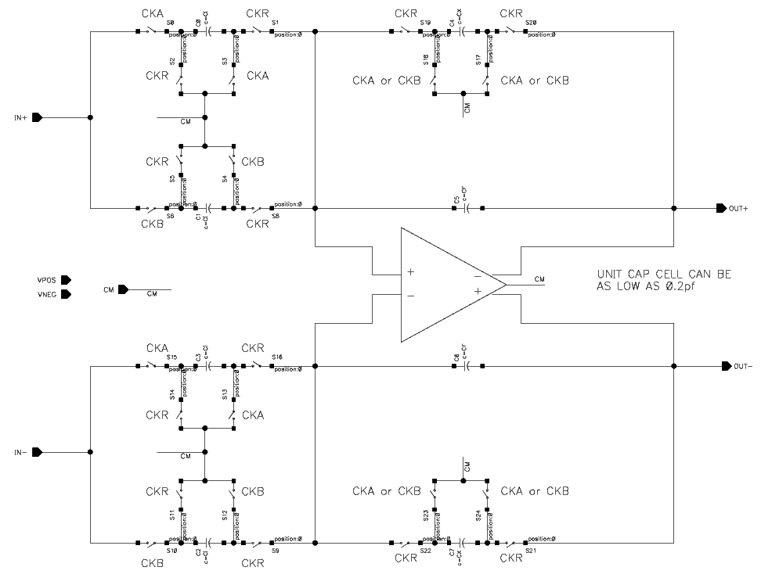
Chopper-Stabilized Amplifiers Fighting Ripple – Tune filtering – Low noise approach (cont)
VOFF + VN
2φ
SF
VSIG
Sinc filter
T_{CK}
CK_{SA}
T_{CK}
CK_{SB}
T_{CK}
CK_{R}

Slide 43
Chopper-Stabilized Amplifiers Fighting Ripple – Tune filtering – Low noise approach (cont)
VOFF + VN
2φ
SF
VSIG
Sinc filter
In band
WN PSD is NOT increased ↑
Out of band
Ripple:
Delay: only limited by AAF ↑
Virtually eliminated ↑
Independent of circuit parameters ↑

Slide 44
Chopper-Stabilized Amplifiers Fighting Ripple – Baseband Offset compensation (RRL)
VOFF + VN
Conventional chopper-stabilized amplifier
Vo
SF
+
-
Modulated offset & 1/f
LP filter
VSIG
1
3
5
f / fch
VOFF + VN
f_{o}<<f_{ch}
VOFF + VN
Modulated signal
1/f
1/f
1
3
5
Time response
Voff
t

Slide 45
Chopper-Stabilized Amplifiers Fighting Ripple – Bandpass Offset compensation (RRL)
VOFF + VN
Conventional chopper-stabilized amplifier
Vo
SF
+
-
Modulated offset & 1/f
VSIG
Tuned BP filter
1
3
5
f / fch
VOFF + VN
f_{o}=f_{ch}
1/f
Time response
Voff
1
3
5
Modulated offset & 1/f
f / fch
t
1
3
5

Slide 46
Chopper-Stabilized Amplifiers Fighting Ripple –Offset compensation (cont)
VOFF + VN
Vo
SF
In band
WN PSD is NOT increased ↑
Out of band
Ripple:
Delay:
Only proportional to 1/Aol ↓
WN Aliasing occurs if feedback tuned filter is used to reduce delay ↓
Prop. to loop speed ↓
+
-
LP filter
f_{o}<<f_{ch}
VOFF + VN
Vo
SF
+
-
Tuned BP filter
f_{o}=f_{ch}

Slide 47
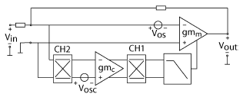
Chopper-Stabilized Amplifiers Fighting Ripple –Offset stabilization
GOAL: Compensate for main amplifier’s offset
+ Continuous-time signal path
- Only for closed loop amplifiers
VOFF + VN
Vo
+
-
Comp amp:
Chopper offset-stabilized
Auto-zero offset-stabilizied
Compensation amp

Slide 48
Chopper-Stabilized Amplifiers Fighting Ripple –Offset stabilization (cont)
VOFF + VN
Main Amp
K/(s+p1)
Vo
+
Output stage
+
Comp Amp
K/(s+p2)
-
Compensation amp
Two forward paths → pole-zero doublets
→ Stability issues!
Hybrid nested Miller
Without HNM comp
-gm2
-gm1
-gm5
-gm4
-gm3
With HNM comp
Requires BW_{MP}=BW_{CP}

Slide 49
Chopper-Stabilized Amplifiers Fighting Ripple – Chopper+AZ
Noise PSD [V]
Noise PSD [V]
V_{off} +V_{n}
Autozeroing frequency - f_{AZ}
V_{off} +V_{n} are decreased
Baseband noise increased
(a) No chopping, no AZ
(b) No chopping, with AZ
V_{off} +V_{n} are decreased
Modulated noise increased
Chopping frequency - f_{ch}
Noise PSD [V]
Noise PSD [V]
V_{off} +V_{n} are decreased
Baseband noise is decreased
Modulated noise increased
Modulated V_{off} +V_{n}
Chopping frequency - f_{ch}
(c) With chopping, no AZ
(d) With chopping, with AZ
f_{AZ} + fch

Slide 50
Chopper-Stabilized Amplifiers Fighting Ripple - Summary
 |  | Ripple cancellation (out of band noise) | Noise aliasing (in band noise) | Delay | CT output | Closed /Open-loop topology | Observations
CT filtering | LPF | - | + | - | Yes | Both | Involves long delays to further reduce ripple
 | HPF | -/+ |  |  |  |  | Slightly better than LPF since ripple is not proportional to offset
Tuned filtering | T&H demod. | + | - | + | Yes | Both | Delay is only related to smoothening LPF
 | Low noise |  | + |  |  |  | Delay is only related to AAF, which can be (marginally) fo=fch
Offset comp. | Baseband offset | + | +^{(*)} | - | Yes | Ideally both. CL only in practice | Delay is proportional to loop speed ^{(*)} Could be poor if discrete time notch filter is used inside the loop
 | Mod. Offset
Offset stabilization | Chopper | -/+ | + | - | Yes | CL only. Stabilization is complex. | Residual ripple from compensation path needs to be minimized
 | AZ |  | - |  | No |  | Folds back baseband noise of compensating amplifier
Chopped AZ | Single | + | +^{(*)} | + | No | Ideally both. CL only in practice
 | Ping-Pong |  |  | + | Yes |  | ^{(*)} Further removed by chopper

Slide 51
Chopper-Stabilized Amplifiers Fighting Limitations - Overview
Fighting Bandwidth
Usual approach
Currents are faster than voltages
Fighting ripple
CT filtering
(DT) Tuned filtering: Track and hold demodulation
(DT) Tuned filtering – revisited: low noise approach
Offset compensation (feedback)
Offset stabilization
Chopped auto-zero
Fighting residual offset
Nested chopping
Guard-banding
Bandpass filtering

Slide 52
Chopper-Stabilized Amplifiers Fighting Residual Offset
What causes residual offset?
How can residual offset be reduced?
Band pass filtering
Currents are “faster than voltages”
Guard banding
Oversampling ratio can be maximized
Chopped cascodes
Nested chopping
Is it required to chop all gain stages ?
Slew rate requirement highly reduced

Slide 53
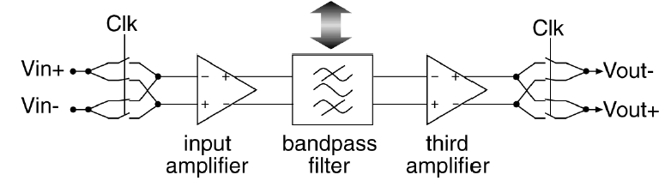
Chopper-Stabilized Amplifiers Fighting Residual Offset – Bandpass Filtering
“A fully integrated, untrimmed CMOS instrumentation amplifier with sub-microvolt offset” – Menolfi et. Al – IEEE JSSC March 1999
f_{o}=2f_{CLK}
front end
amplifier
Back end
amplifier
Modulated RESOFF & CM errors
RESOFF & CM errors
f / fch
1
2
3
4
5
f / fch
1
2
3
4
5
f / fch
1
2
3
4
5
Requires very good matching between fo and fch

Slide 54
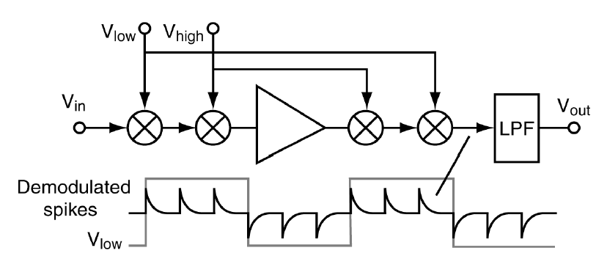
Chopper-Stabilized Amplifiers Fighting Residual Offset – Nested Chopper
“A CMOS Nested-Chopper Instrumentation Amplifier with 100-nv Offset” - Bakker et.al – IEEE JSSC Dec 2000
Modulated @ f_{high}
RESOFF & CM errors
RESOFF & CM errors
Modulated @f_{low}
RESOFF & CM errors
f / fch
f / fch
1
2
3
4
5
f / fch
1
2
3
4
5
1
2
3
4
5
Requires tighter LPF f-3dB < flow

Slide 55
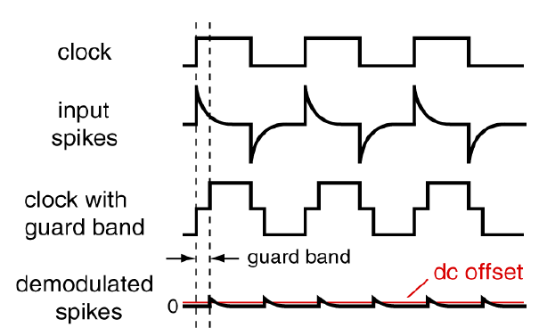
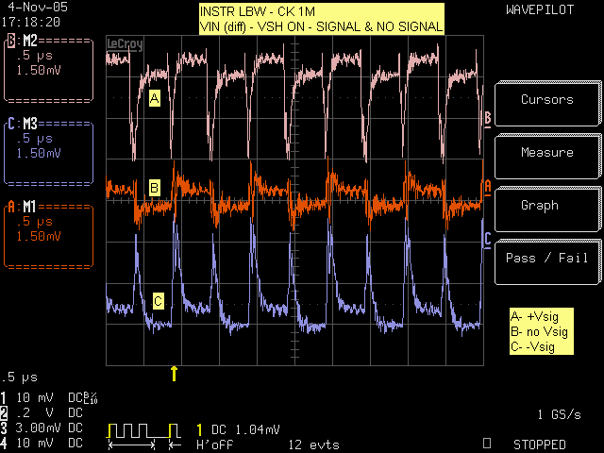
Chopper-Stabilized Amplifiers Fighting Residual Offset – Guardbanding
A. Bilotti, G. Monreal, “Chopper-stabilized amplifiers with a track-and-hold signal demodulator,” IEEE Trans. On Circuits & Systems-I, April 1999
Slightly worse noise performance.
Output is not available during guard band
Modulated RESOFF & CM errors
1
2
3
4
5
f / fch

Slide 56
Wrap Up

Slide 57
Static Offset Cancellation: This involves permanent adjustments to compensate for initial offset errors. Hall Plates (Dual/Quads): Uses multiple Hall plates with opposing sensitivities to cancel out offset. Accuracy relies on matching between the plates. More current is consumed. Thermal noise is reduced, but flicker noise remains. Amplifiers (Trimming): A digital-to-analog converter (DAC) is used to trim the amplifier's offset. The accuracy of this method is limited by the DAC resolution (typically not effective beyond 5 bits). Various trimming methods are available (laser trimming, fusible links, PROM). Dynamic Offset Cancellation: This involves continuous modulation and signal processing techniques to dynamically eliminate offset and 1/f noise. Hall Plates (Current Spinning): A single Hall plate is used, but the bias current is cycled through different phases to modulate the offset. This effectively moves the offset away from DC, allowing it to be filtered out. Amplifiers (Auto-Zeroing, Chopping, Offset Stabilization): Various techniques are described, including: Auto-Zeroing: Periodically samples and subtracts the offset. Leads to a sampled data output. Chopping: Modulates the signal to a higher frequency, shifting the offset and 1/f noise away from DC, allowing for filtering. Results in a continuous-time output but introduces ripple (harmonic noise) and signal delay. Offset Stabilization: Uses a secondary compensation amplifier to cancel the main amplifier's offset in a closed-loop configuration.

Slide 58
Trade-offs Residual Noise vs. SNR/Dynamic Range/Delay: Dynamic techniques, while effective at reducing offset and 1/f noise, often introduce residual noise (e.g., ripple in chopping). The choice of filtering methods (CT filtering, feedback, tuned filtering) significantly impacts the trade-off between residual noise, signal-to-noise ratio (SNR), dynamic range, and signal delay. Residual Offset vs. Efficiency: Static offset cancellation can be less efficient in terms of power consumption, especially when using multiple Hall plates. Dynamic methods can achieve better efficiency. BW Limitation (Speed) vs. Gain Accuracy: Chopping, while effective for offset cancellation, can limit the bandwidth of the amplifier due to the chopping frequency and the need for low-pass filtering. This limitation affects the speed of the amplifier's response. Additionally, achieving precise gain accuracy can be more challenging with chopping techniques

Slide 59
Tareas
implementación circuito de bias y current spinning de Hall plate
Modelado funcional (componentes ideales) por bloques en cadence.
Estos bloques, luego de ser verificado a nivel funcional, serán reemplazados por su versión a nivel de transistores.
Incluir Fuentes de offset en el modelo de transductor para comprobar la correcta modulación de estas en el proceso de choppeado
Incluir coeficientes de temperatura en generación de tensión / Corriente y parámetros principales según corresponda.
Modelado circuital
implementación a nivel de transistores del circuito de bias.
Detallar tamaño de transistores usados para la conmutación de la Hall plate (W,L)
Para ambos modelos
Simular punto de operación y transitorios de conmutación verificando salida diferencial de la celda Hall acorde al campo aplicado (sensitivity check), y tensión o Corriente de bias.
implementación de amplificador choppeado de interfaz de Hall
Modelado funcional (componentes ideales) de un amplificador choppeado.
verificación funcional (transitorios) con y sin offset aplicados.
Verificación de ganancia y offset residuales.
Incluir coeficientes de temperatura en parámetros principales según corresponda.
Modelado circuital
verificación funcional (transitorios) con y sin offset aplicados.
Verificación de ganancia y offset residuales.
Incluir coeficientes de temperatura en parámetros principales según corresponda.
Detallar tamaño de transistores usados (WL) y topología usada para etapa de entrada y salida del amplificador.
Para ambos modelos
Simular punto de operación y transitorios de conmutación verificando salida diferencial acorde al campo aplicado

Slide 60
References
“Circuit techniques for reducing the Op-Amp imperfections: Autozeroing, Correlated Doubling Sampling and Chopper stabilization” – C. Enz, et. al. – Proceedings of the IEEE. Nov. 1996
“Power, accuracy and noise aspects in CMOS mixed-signal design” – M.A.T. Sanduleanu - ISBN: 90-3651265-4 - ©1999, M.A.T. Sanduleanu
“CMOS single chip electronic compass with microcontroller “– Schott, et.al - IEEE JSSC Dec 2007
“Monolithic Magnetic Hall sensor using dynamic quadrature offset cancellation” – A. Bilotti, G. Monreal, R. Vig – IEEE JSSC June 1997
Chopped Hall effect Sensor – G. Monreal, H. Romero – US7425821
“A Chopped Hall Sensor With Small Jitter and Programmable “True Power-On” Function“ – Motz et.al – IEEE JSSC Jul. 2005
“Auto-correction feedback for Ripple Suppression in a Chopper Amplifier” – Kusuda – IEEE JSSC Aug 2010 – p. 1436-1445.
“A Chopper Current-Feedback Instrumentation Amplifier with a 1mHz 1/f Noise Corner and an AC-Coupled Ripple reduction loop” – R. Wu, et.al. - IEEE JSSC – Dec 2009 – p. 3232-3243
“A CMOS Chopper Offset-Stabilized Opamp “ – Witte et. al. – JSSC IEEE Jul 2007
“Chopper stabilization of MOS Operational Amplifiers using feed-forward Techniques” – Coln – IEEE JSSC Dec 1981, p. 745 -748.
“Frequency stabilization of chopper-stabilized amplifiers”. J. Huijsing, et.al. – US 7209000.
“Switched capacitor Notch filter “– H. Romero – US 7990209
“A 1V low noise CMOS amplifier using noise reduction technique of Autozeroing and chopper stabilization” - Yoshihiro Masui, et. al. – Hiroshima University.

Slide 61
Until next Friday…

